Slide 1
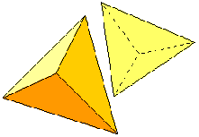
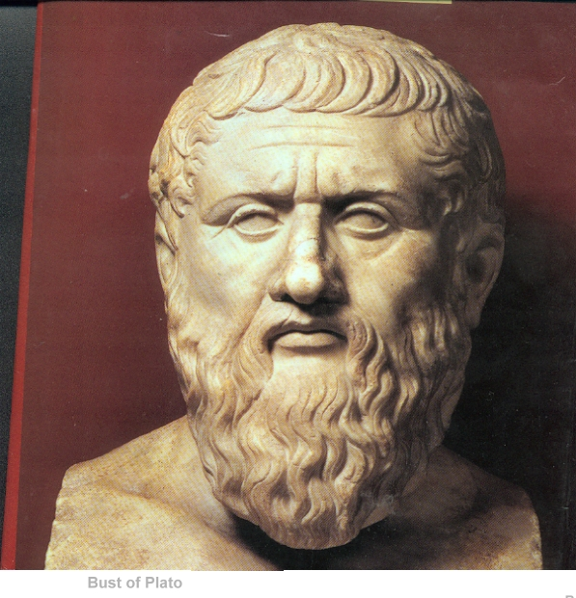
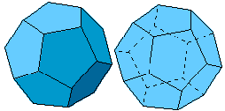
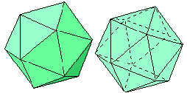
Page 114
The Five Platonic Solids
Plato
Greek philosopher 427 - 347 BC
wrote about them.
There are only five ways
to completely enclose a space
using only one shape.
Michael S. Schneider
www.constructingtheuniverse.com

Slide 2
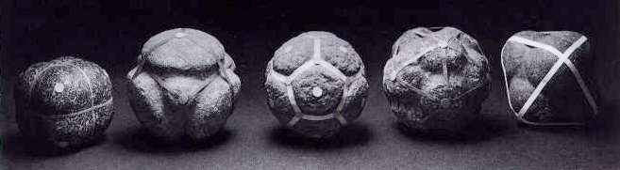
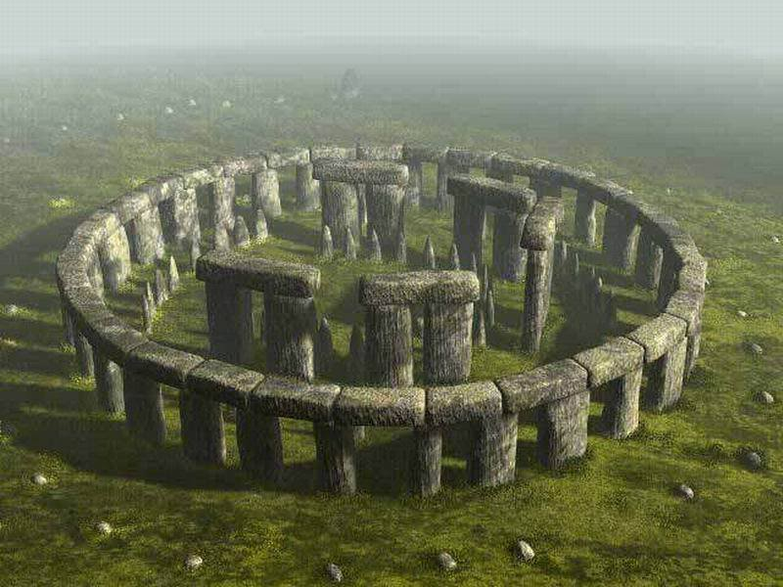
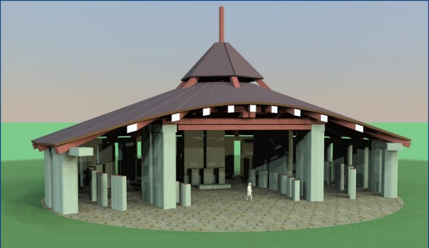
Oldest known examples
1500 BC
Scotland
Hexa-
Tetra-
Dodeca-
Icosa-
Octa-
Stonehenge today
Stonehenge reconstructed
Used for teaching in ancient
stone- and wood-circle schools.

Slide 3
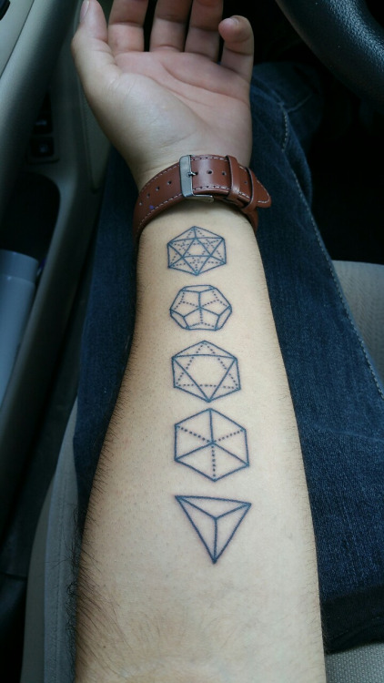

Slide 4
They’re also called
The 5 Regular Polyhedra
Poly- = “Many”
-Hedra = “Seats” (faces)
Page 114
But they’re called "Regular" polyhedra which means that
everything about them is equal:
In each:
All corners are an equal distance from the center.
All edge lengths are equal.
All faces are identical regular polygons.
All angles are the same.

Slide 5
Page 114
1
Tetrahedron
In three dimensions there are only these five:
3 are made of triangles
1 is made of squares
1 is made of pentagons
Their names come from their number of faces:
1) Tetra-hedron - made of 4 equilateral triangles
2) Hexa-hedron (Cube) - made of 6 squares
3) Octa-hedron - made of 8 equilateral triangles
4) Dodeca-hedron - made of 12 regular pentagons
5) Icosa-hedron - made of 20 equilateral triangles
2
Hexahedron
Octahedron
3
Dodecahedron
4
5
Icosahedron

Slide 6
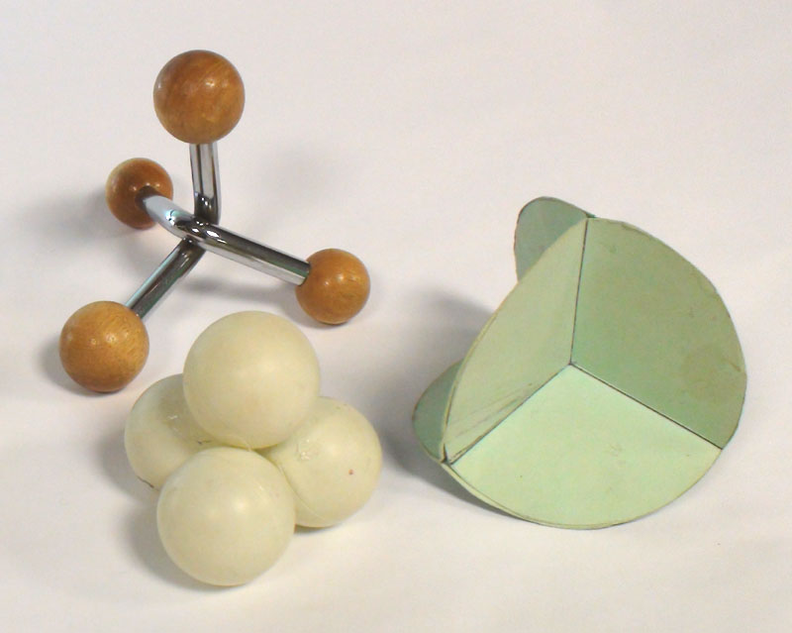
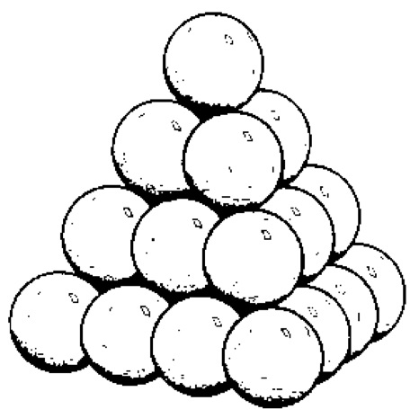
The Tetrahedron appears in a variety of forms

Slide 7
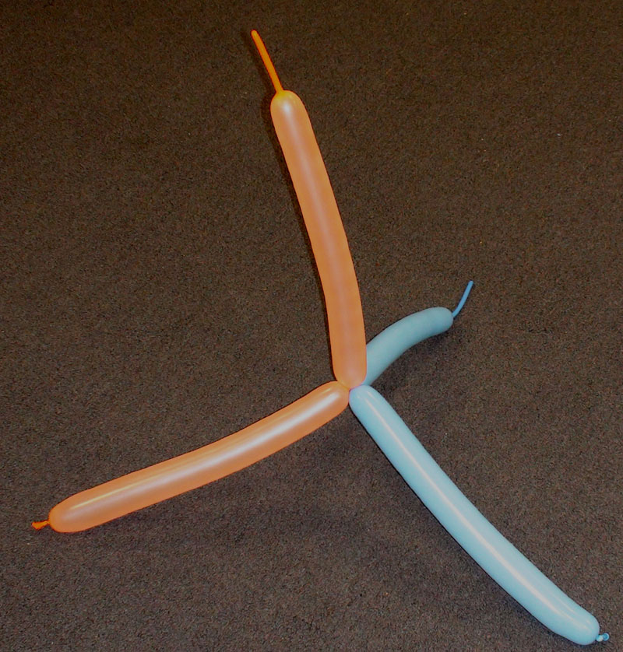
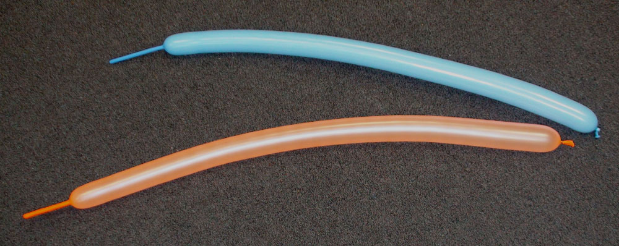
The easiest way to construct a Tetrahedron

Slide 8
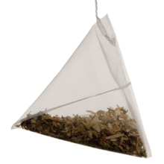

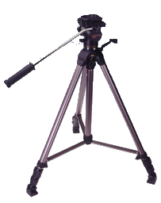
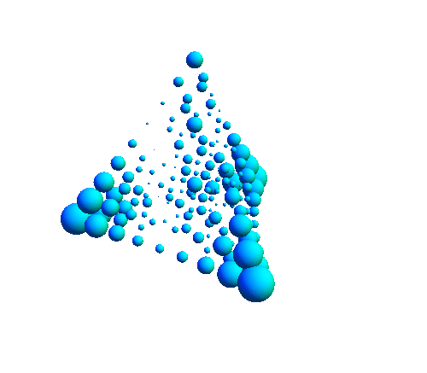
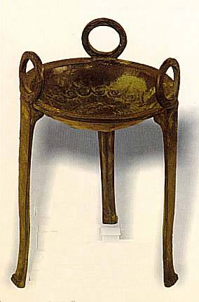
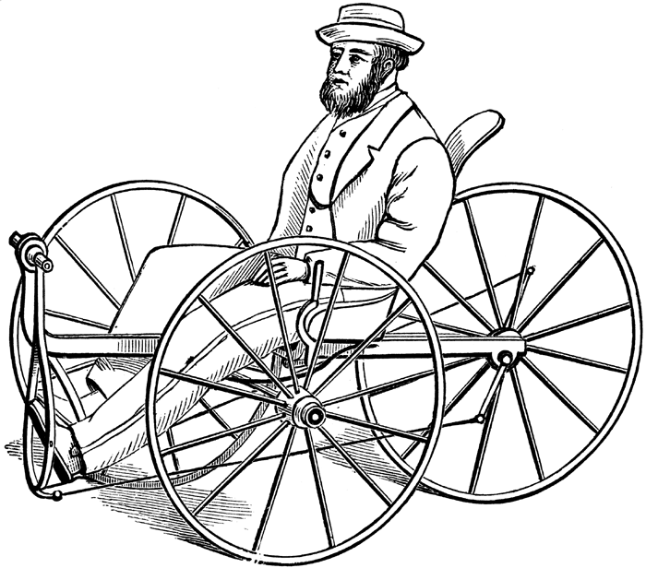
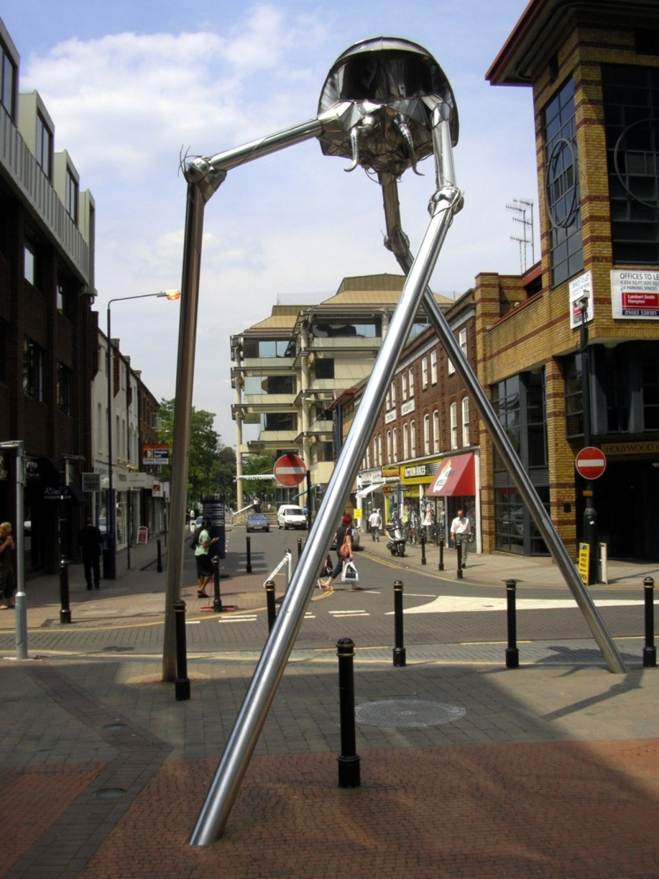
The Tetrahedron
4 Triangles
Teabag
Tripods

Slide 9
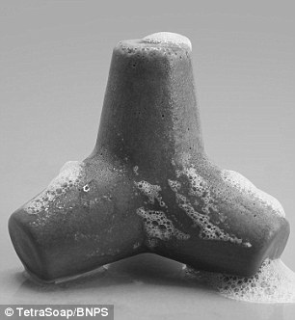
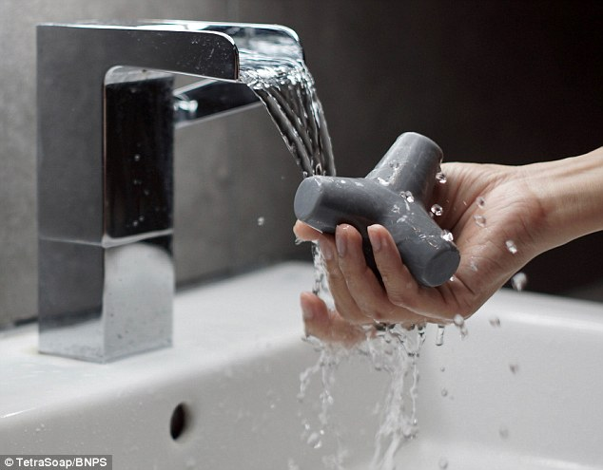
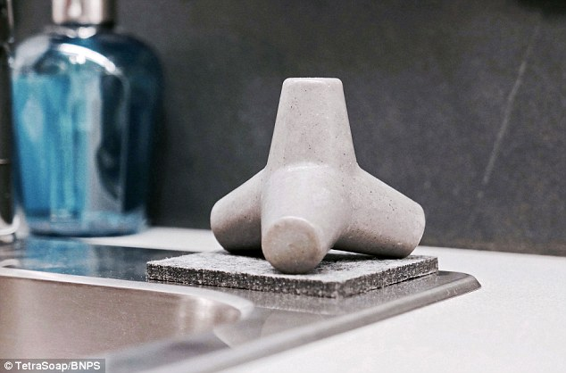
Tetra Soap
Easier to grip so it doesn’t easily slip out of your hands, and it dries faster.

Slide 10
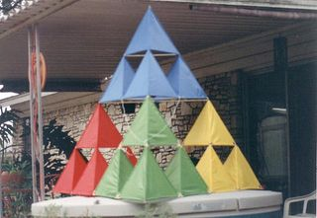
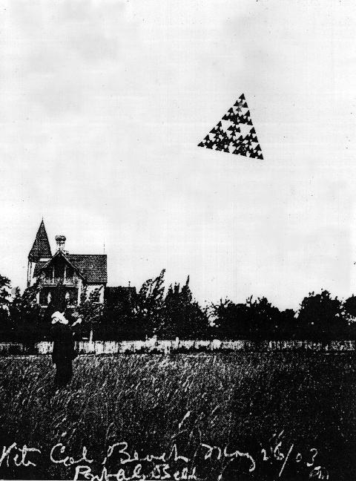
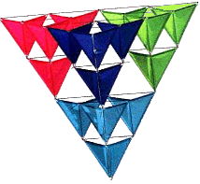
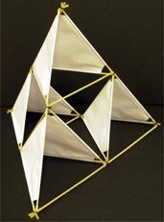
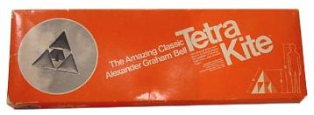
1
tetrahedron
x 4 =
x 4 =
x 4 =
Tetrakite
Invented by
Alexander Graham Bell

Slide 11
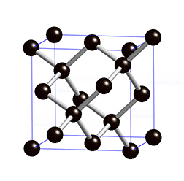
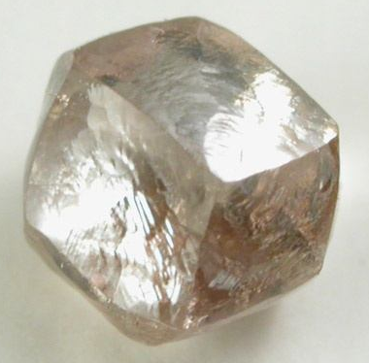
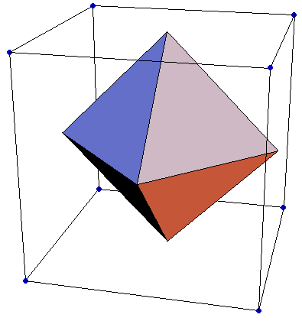
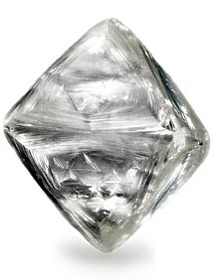
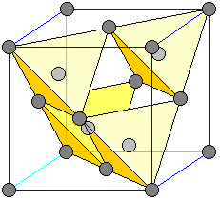
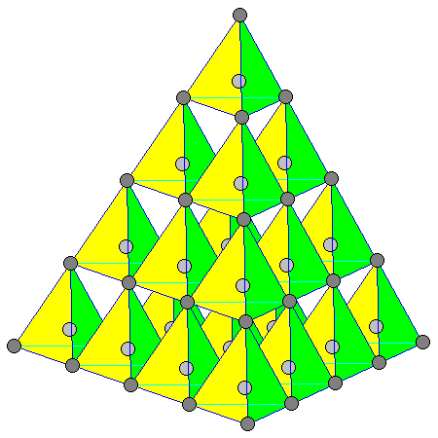
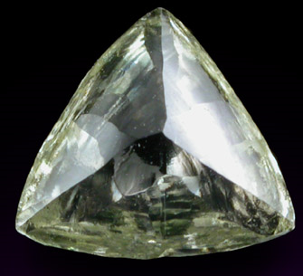
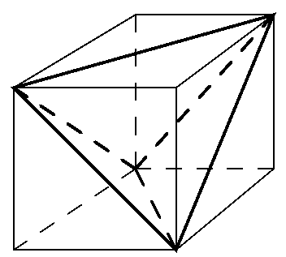
Diamond crystals can grow into the related forms of cubes, tetrahedra and octahedra
Diamond Crystal
Carbon atoms in a diamond arrange as strong tetrahedra

Slide 12
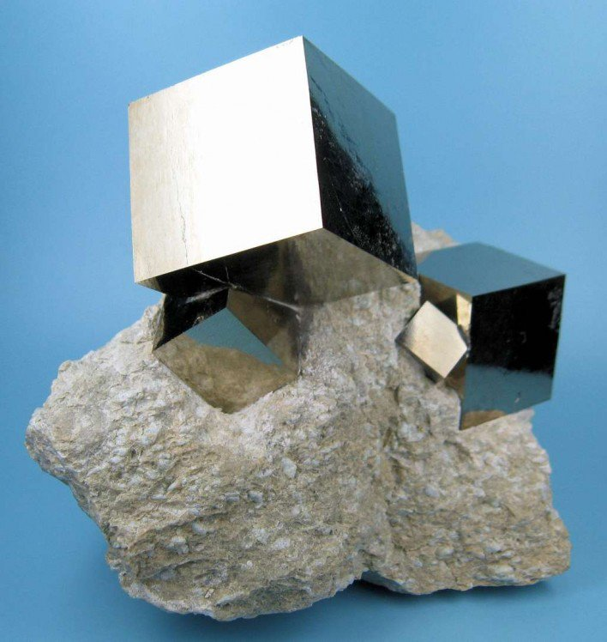
Cube
Or
Hexahedron
Iron Pyrite
(“Fool’s Gold”)

Slide 13
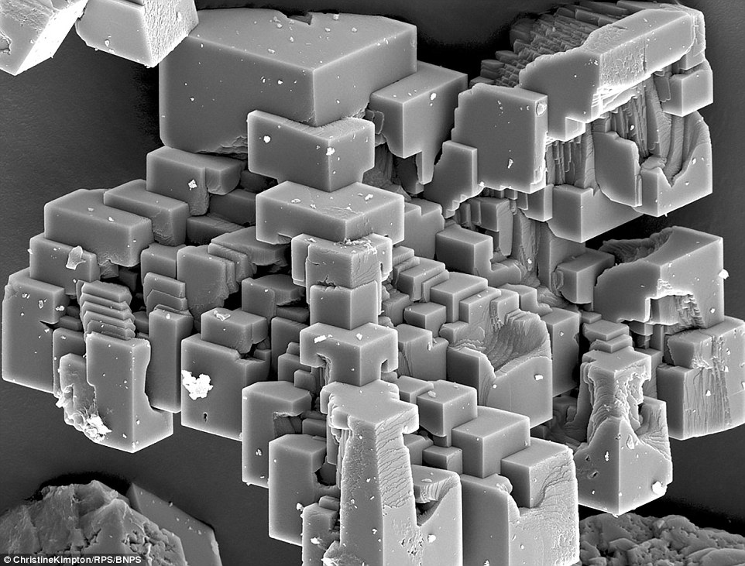
Calcium Carbonate
“Chalk”

Slide 14
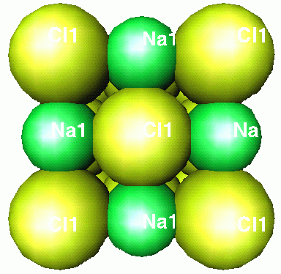
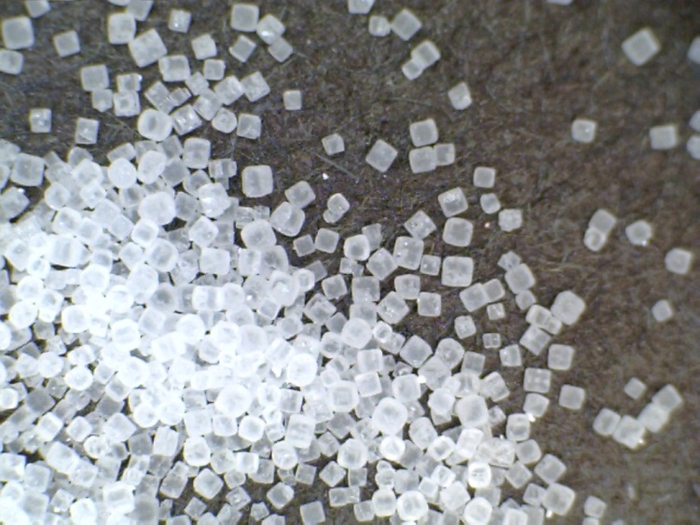
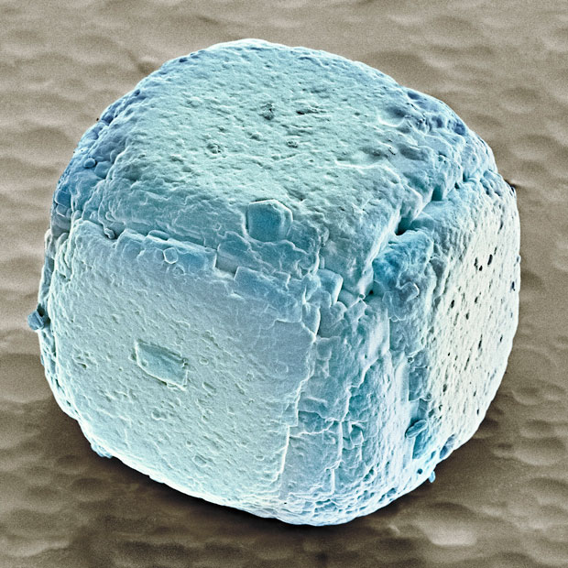
Salt
Sodium Chloride NaCl
Sodium – metal explodes on contact with air
Chlorine – poisonous gas
But we need it!

Slide 15

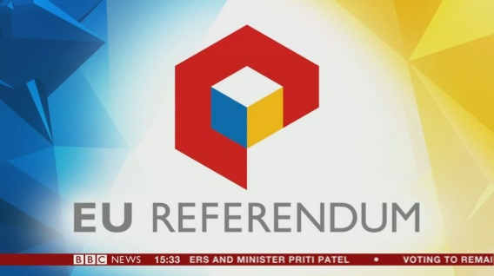


CubicLogos
Create a logo which uses the cubic form

Slide 16
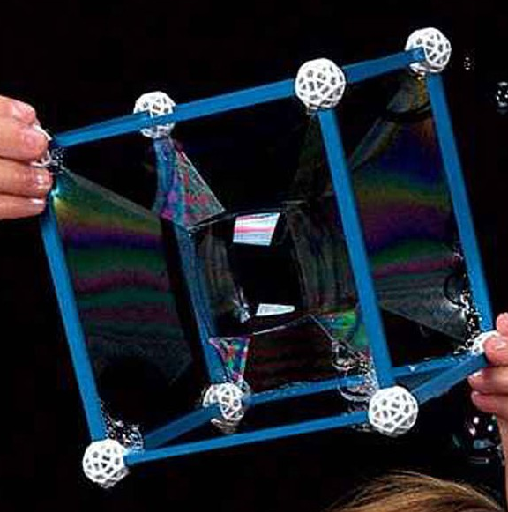
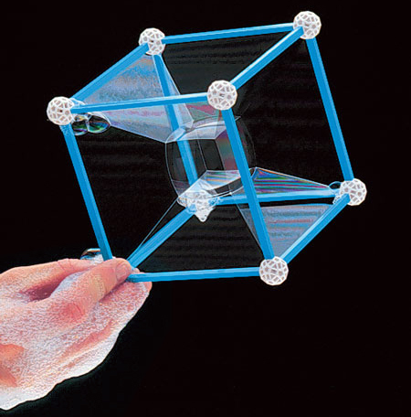

Slide 17
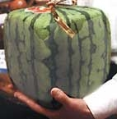
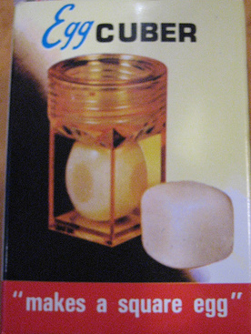
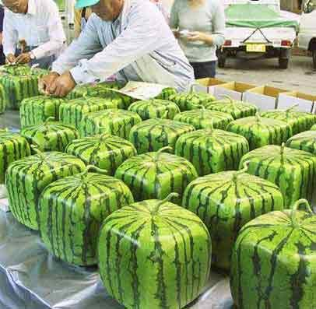
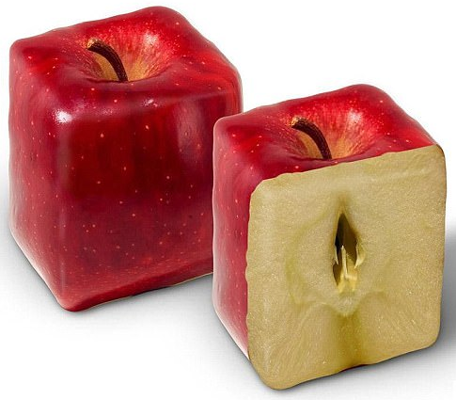
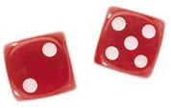
Hexahedron
(cube)
6 Squares
Why?
What are it’s advantages?
The opposite sides of honest dice add to 7

Slide 18
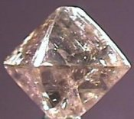
The Octahedron
8 Triangles
Diamond crystal
Keep cutting the corners off a cube to produce an octahedron.

Slide 19
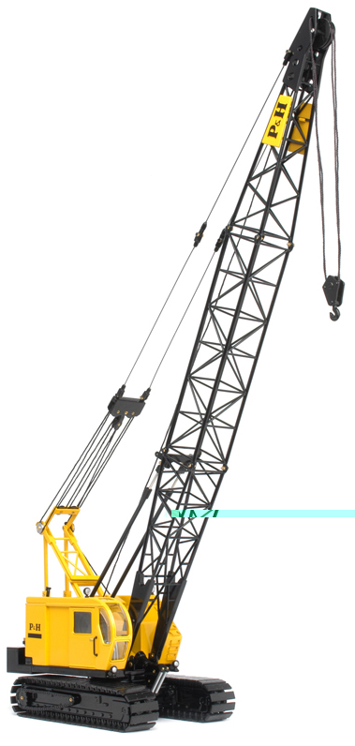
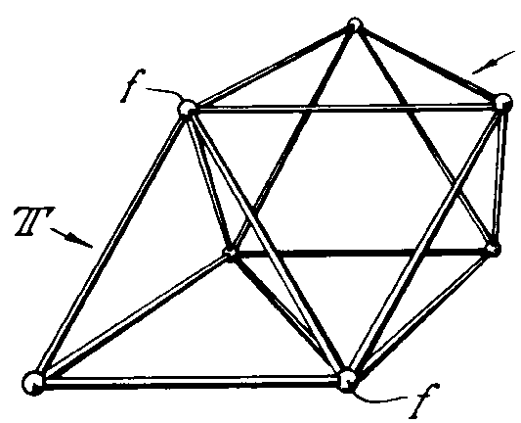


Octahedron + Tetrahedron = Octet Truss
+
All strong triangles

Slide 20





The Dodecahedron
12 Pentagons
Dodeca Dice
Another form of the Iron Pyrite crystal
Wood Stove

Slide 21


Slide 22

Soccer Ball
Based on the Dodecahedron
It’s 12 pentagons shrunk and the space between is filled with hexagons.
(Hexagons alone can’t enclose 3D space.)

Slide 23



Drawn by
Leonardo
da Vinci
The Icosahedron
20 Triangles

Slide 24


Slide 25


Slide 26

Human size
is to
Bacteria size
as
Bacteria size
is to
Virus size!

Slide 27

Page 115

Slide 28
Page 115
Hexa
Dodeca
Octa
Tetra
Icosa
Icosa
Hexa
Tetra
Dodeca
Dodeca
Hexa
Tetra
Icosa

Slide 29





Pentagon
5
Notice the bent ends
Rectangle
4
Triangle
3
Pentagon
5
3x4x5 = 60 holes
What can you create
with ZomeTool kits?

Slide 30




Balloon
Geometry

Slide 32



Triangles enclose 3-Dimensions
Quartz
Tetrahedron
4 triangles
Octahedron
8 triangles
Icosahedron
20 triangles
Diamond
Micro Life

Slide 33



Tripod Robots

Slide 34

Thorns of the Keepaway Tree

Slide 35



Slide 36

“You never change things by fighting the existing reality.
To change something, build a new model that makes the existing model obsolete.”
- R. Buckminster Fuller
“Most of my advances were by mistake. You uncover what is when you get rid of what isn't.”

Slide 37

The Icosahedron appears as many Virus types
Each is based on the Platonic Solids

Slide 38

Icosahedron
Octahedron
Dodecahedron

Slide 39

See the Pentagon face?

Slide 40



Passion Flower Pollen
Versions of the Tetrahedron
Different purposes – same plan!

Slide 41

Basket Fungus -- a Dodecahedron!

Slide 42

Shadows through a Dodecahedron

Slide 43



Synergy
“work together”
The whole is greater (or less)
than the sum of its parts.

Slide 44


Tetrakite
Invented by
Alexander Graham Bell
Mr. & Mrs. Bell
Mrs. & Mr. Bell

Slide 45

Pages 118-121
Tessellations on Platonic Solids

Slide 46

Page 116
Dymaxion Map by Buckminster Fuller
Produces less distortion than any other flat map.
Shows the land connections: “One Island Earth"

